Slide 1
Linear Regression
Submitted By : Pramod Kulkarni
Nov Batch (BDS)

Slide 2
1.What is Linear regression .
Linear regression algorithm shows a linear relationship between a dependent (y) and one or more independent(x) variables , hence called as
Linear regression .
Example: Salary of person based on past experience.

Slide 3
2) What are the different types of linear regression .
. Simple Linear Regression : It is a regression model that estimates the relationship between one independent variable and one dependent variable using a straight line .Both variable should be quantitative .
Multiple Linear Regression : It is a statistical technique that uses several explanatory variables to predict the outcome of a response variable .

Slide 4
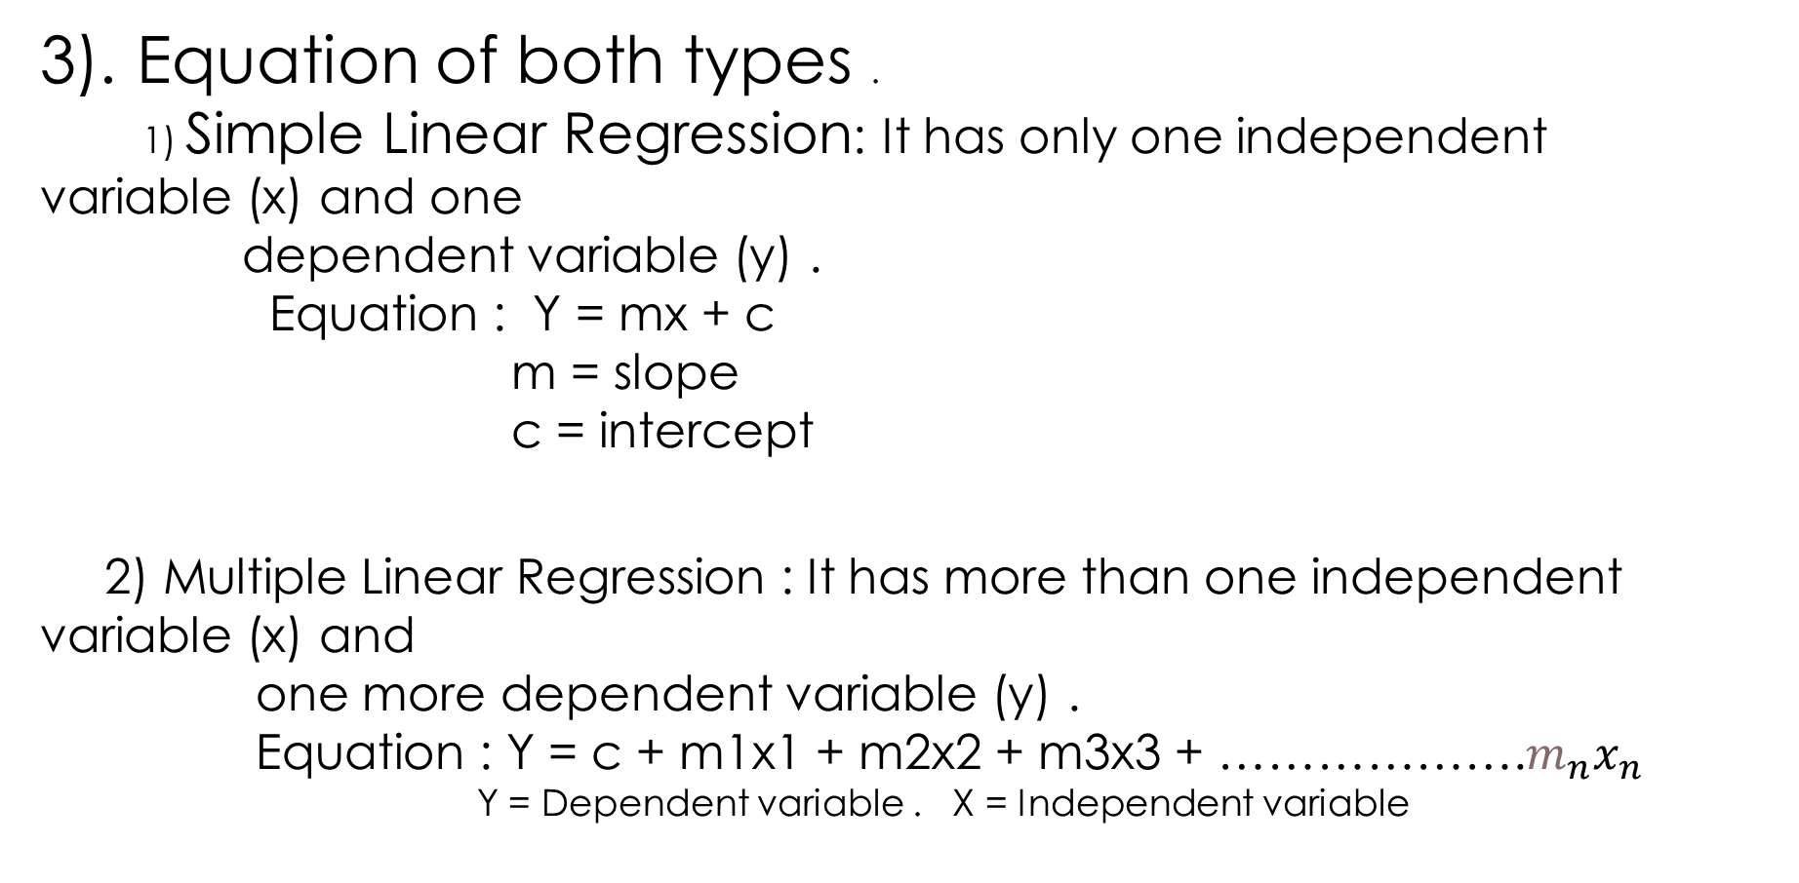
3). Equation of both types .
1) Simple Linear Regression: It has only one independent variable (x) and one
dependent variable (y) .
Equation : Y = mx + c
m = slope
c = intercept
2) Multiple Linear Regression : It has more than one independent variable (x) and
one more dependent variable (y) .
Equation : Y = c + m1x1 + m2x2 + m3x3 + ……………….$m_{n}x_{n}$
Y = Dependent variable . X = Independent variable

Slide 5
4) Example of both type .
Simple Linear Regression :
Example : 1) Salary of person depends only on past experience .
2) Mark obtained by student based on number of hour.

Slide 6
Representation of Simple Linear Regression
Price
(k€)
Age
30
25
20
15
10
1 2 3 4 5

Slide 7
2) Multiple Linear Regression :
Example : 1) House price prediction .
2) Salary hike in company.
SQFT | BEDROOM | BATH | PRICE IN $
2500 | 5 | 3 | $550.000
1900 | 4 | 2 | $470.000
1400 | 3 | 1.5 | $430.000
3200 | 6 | 4 | $750.000

